Slide 1
Unicorn companies Exploratory Analysis created with Jupyter Notebook
By Adeola Aderinola
19-08-2023.

Slide 2
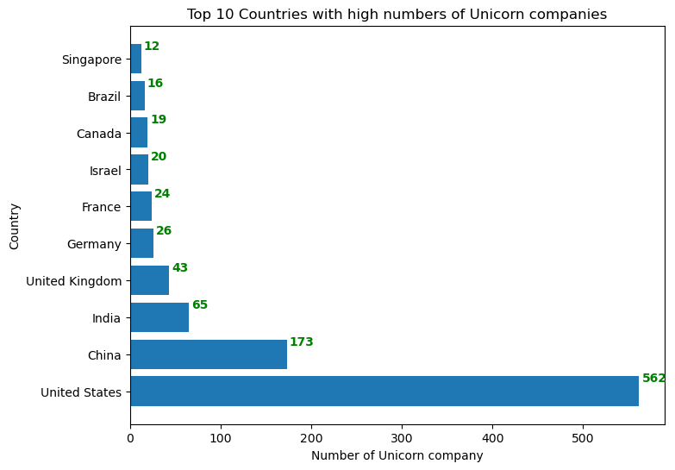
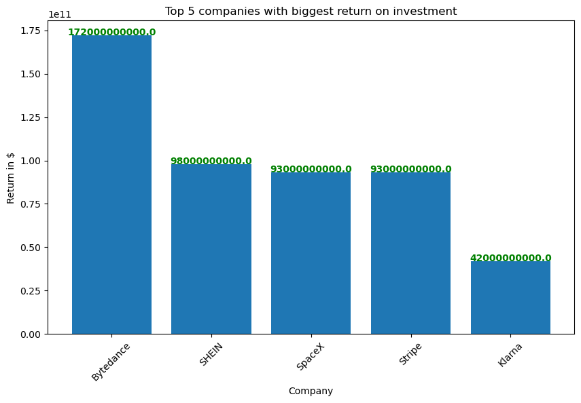
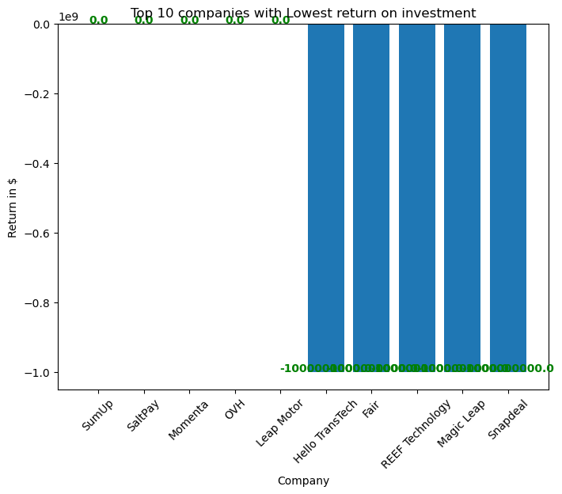
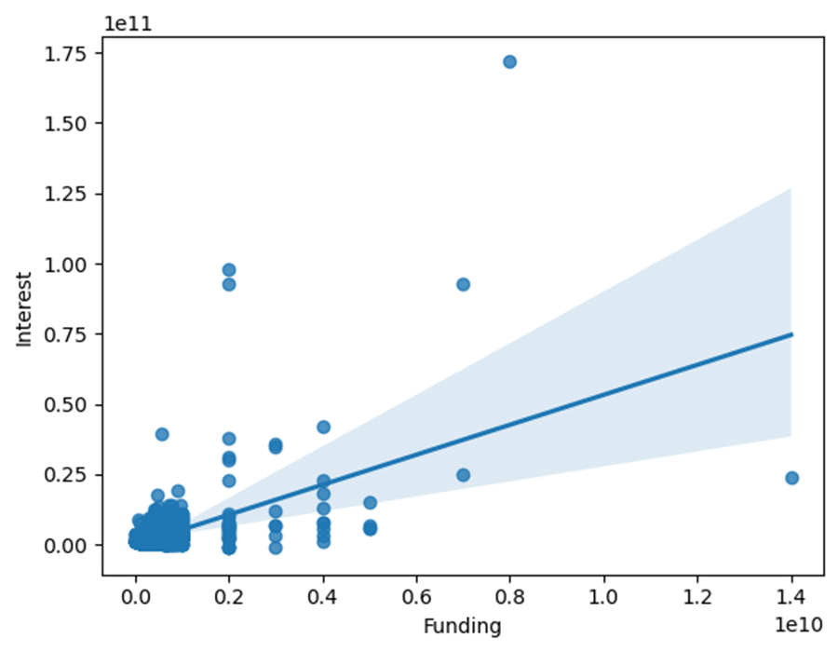
KEY INSIGHTS

Slide 3
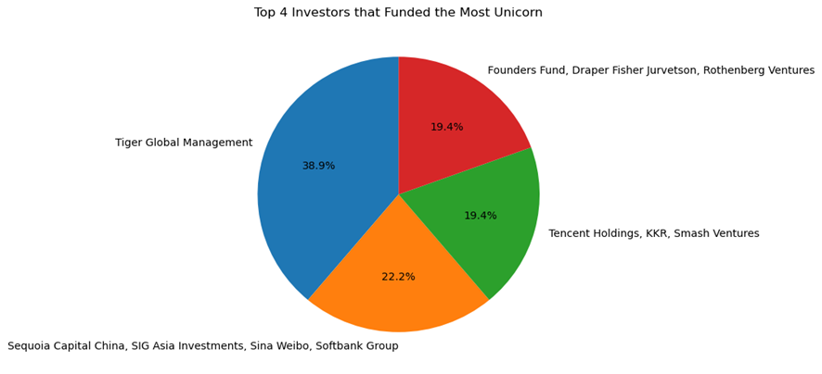
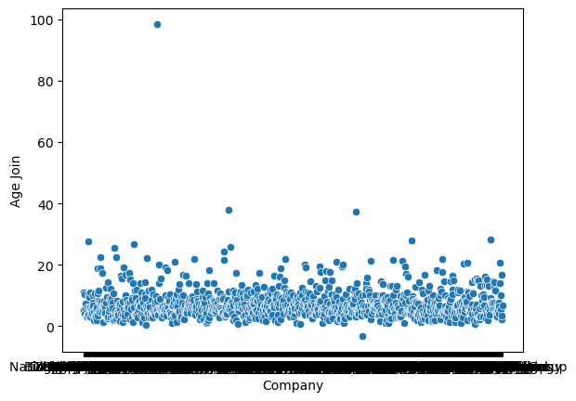
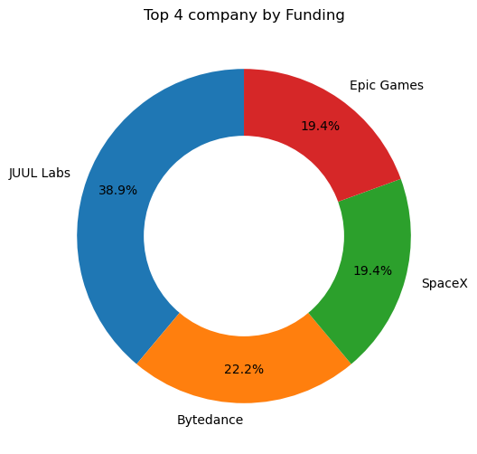
KEY INSIGHT CONT’D

Slide 4
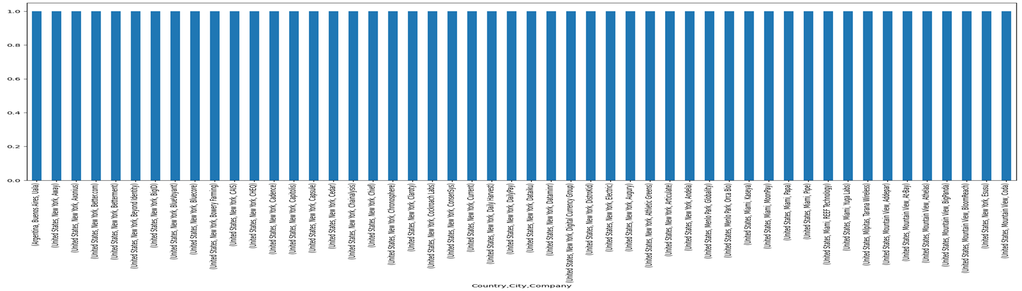
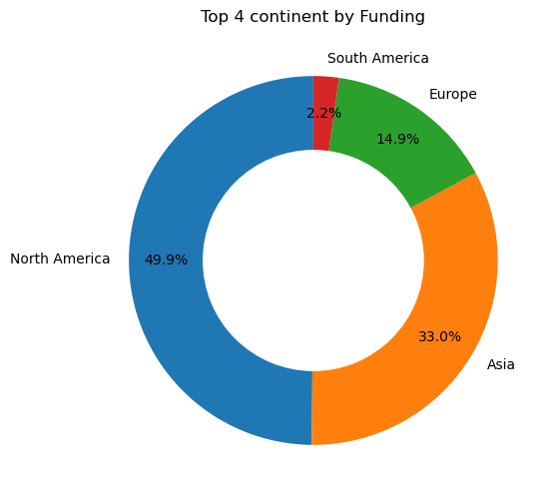
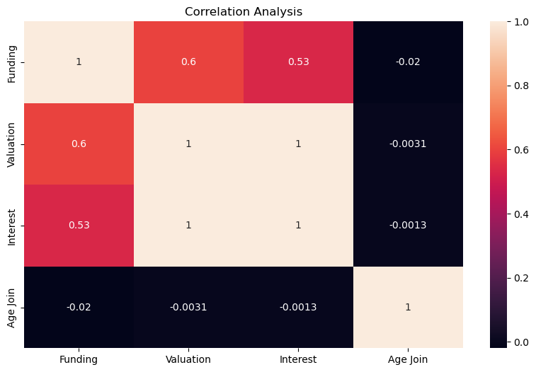
KEY INSIGHT CONT’D

Slide 5
Recommendation
The High Funding of the company has relative impact on the investment return, so the funding should be improve, in order to give big returns.
The period of attaining the Unicorn company should not be much because it has not result on the investment.10months is good to start.
Other countries apart from United States and China should be motivated to invest more on unicorn companies.
Unicorn companies with low returns should be monitored and managed properly to improve the company growth.

